Slide 1
Lecture 3 : CSE2004 – DBMS
Database environment and Architecture

Slide 2
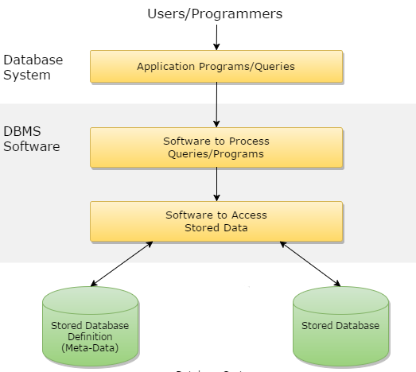
Database Environment

Slide 3
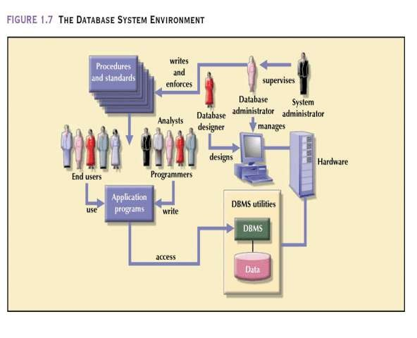

Slide 4
Database Architecture in DBMS
1-tier architecture
2-tier architecture
3-tier architecture

Slide 5
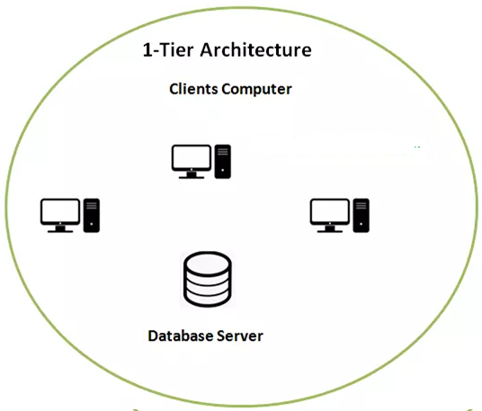
1 - Tier

Slide 6
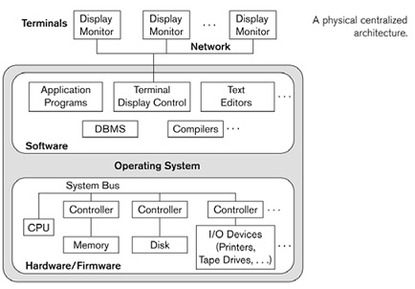
1 – Tier / Centralized architecture

Slide 7
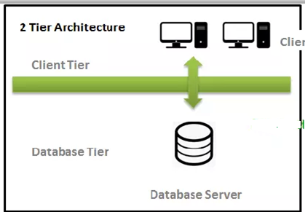
2 - Tier

Slide 8
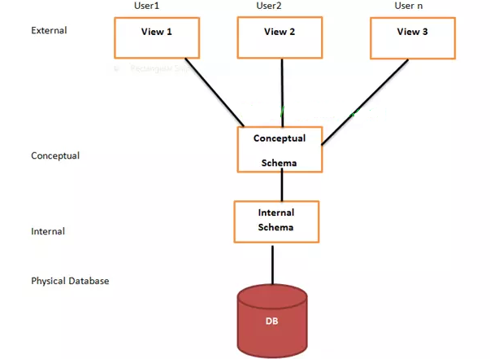
3 - Tier
Three-level architecture
External Views
The level where user organized data is called an external view.
Conceptual View
The conceptual level lies between the internal and external level. It provides the way between them.
Internal View
The level where the operating system and DBMS differentiate the data is called internal view. Here all the data is stored used different data structure and files.

Slide 9
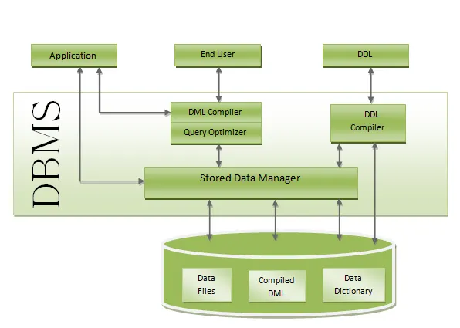
Overall Database System Structure

Slide 10
Applications: – It can be considered as a user-friendly web page where the user enters the requests. Here he simply enters the details that he needs and presses buttons to get the data.
End User: – They are the real users of the database. They can be developers, designers, administrators, or the actual users of the database.
DDL: – Data Definition Language (DDL) is a query fired to create database, schema, tables, mappings, etc in the database. These are the commands used to create objects like tables, indexes in the database for the first time. In other words, they create the structure of the database.
DDL Compiler: – This part of the database is responsible for processing the DDL commands. That means this compiler actually breaks down the command into machine-understandable codes. It is also responsible for storing the metadata information like table name, space used by it, number of columns in it, mapping information, etc.
DML Compiler: – When the user inserts, deletes, updates or retrieves the record from the database, he will be sending requests which he understands by pressing some buttons. But for the database to work/understand the request, it should be broken down to object code. This is done by this compiler. One can imagine this as when a person is asked some question, how this is broken down into waves to reach the brain!
Query Optimizer: – When a user fires some requests, he is least bothered how it will be fired on the database. He is not all aware of the database or its way of performance. But whatever be the request, it should be efficient enough to fetch, insert, update, or delete the data from the database. The query optimizer decides the best way to execute the user request which is received from the DML compiler. It is similar to selecting the best nerve to carry the waves to the brain!
Stored Data Manager: –
It converts the requests received from query optimizer to machine-understandable form. It makes actual requests inside the database.
It helps to maintain consistency and integrity by applying the constraints. That means it does not allow inserting/updating / deleting any data if it has child entry. Similarly, it does not allow entering any duplicate value into database tables.
It controls concurrent access. If there are multiple users accessing the database at the same time, it makes sure, all of them see correct data. It guarantees that there is no data loss or data mismatch happens between the transactions of multiple users.
It helps to back up the database and recovers data whenever required. Since it is a huge database and when there is any unexpected exploit of the transaction, and reverting the changes is not easy. It maintains the backup of all data so that it can be recovered.
Data Files: – It has the real data stored in it. It can be stored as magnetic tapes, magnetic disks, or optical disks.
Compiled DML: – Some of the processed DML statements (insert, update, delete) are stored in it so that if there are similar requests, it will be re-used.
Data Dictionary: – It contains all the information about the database. As the name suggests, it is the dictionary of all the data items. It contains a description of all the tables, view, materialized views, constraints, indexes, triggers, etc.

Slide 11
Classification of Database
Based on the data model
Network database
Hierarchical database
Relational database
Object oriented database
Based on the number of users
Single user
Multiple users
Based on the sites over which network is distributed
Centralized database system
Distributed database system
Homogeneous DBMS
Heterogeneous DBMS
Based on the usage
OLTP, OLAP, Multimedia, GIS, Sensor data, Mobile database

Slide 12
Thank you

